Slide 1
Autodesk Moldflow Communicator 2019 User Manual

Slide 2
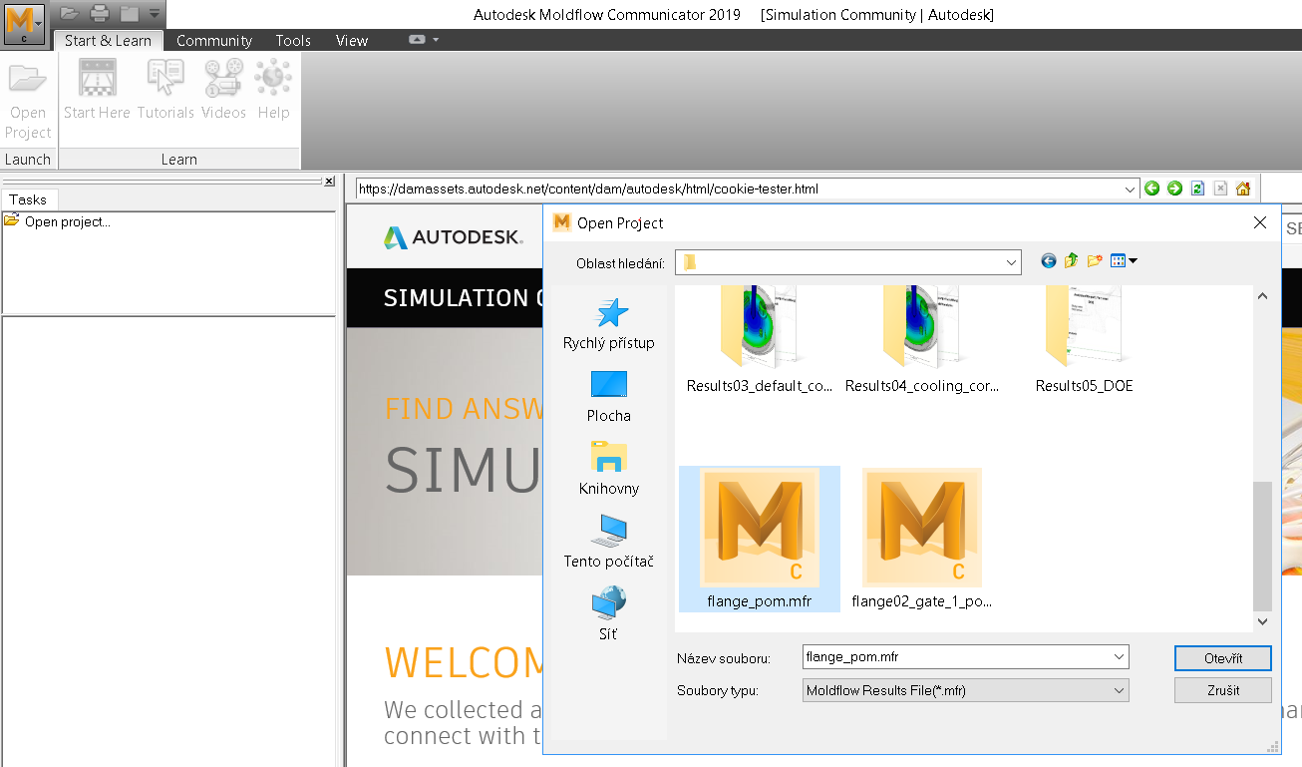
Result file upload
1. Open project in Tasks
2. Choose the respektive result file in .mfr format
3. Open

Slide 3
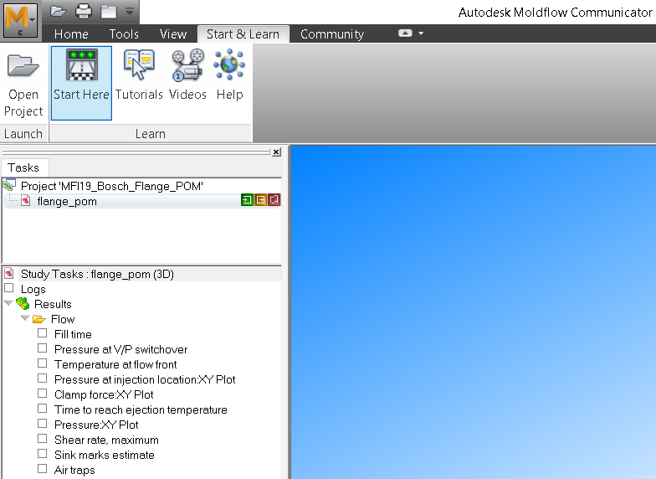
First start
At first usage we recommend to use Start & Learn function

Slide 4
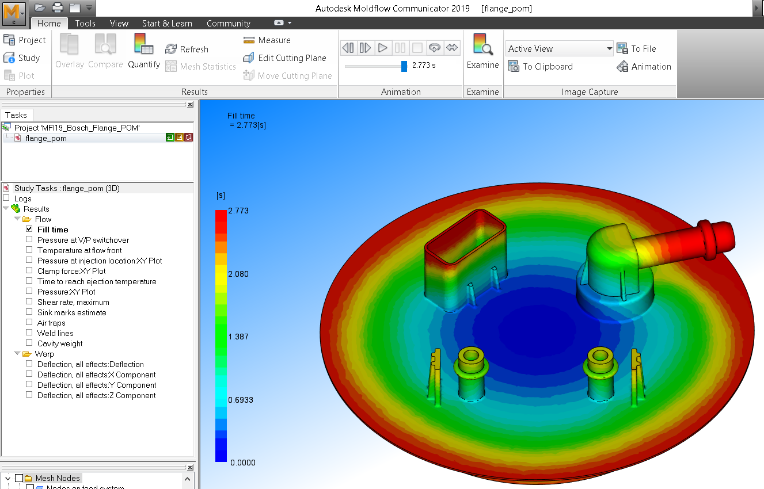
Tools at Home page
Home page contains tools for result evaluation
Measure function – distance measurement
Edit cutting plane – result display in cross-section of the part
Animation – result display in time section
Examine – result value at certain point and time
Image capture – screenshot (video) export to cache or to the hard disc

Slide 5
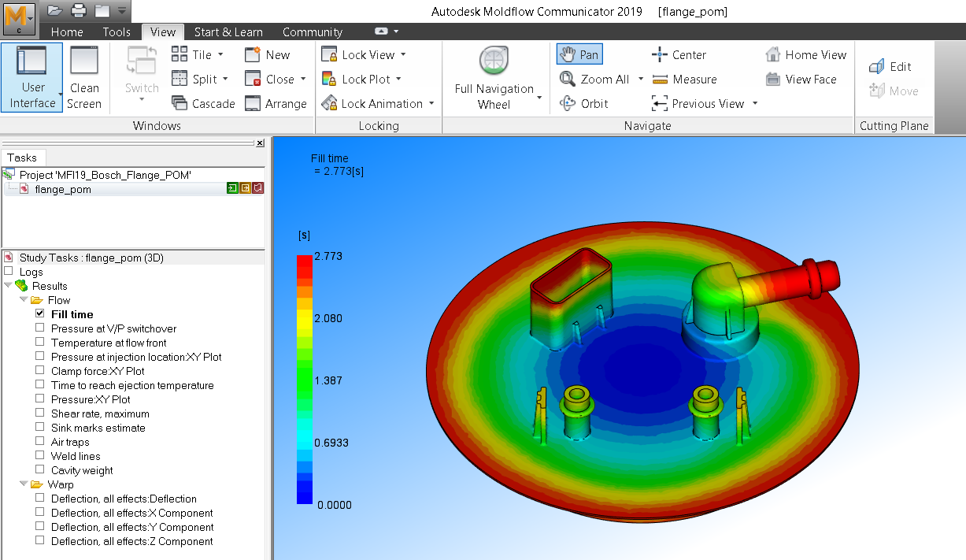
Tools at View page
Rotation centre
Cutting plane
Tools for positioning and rotation of the model
Control of the object display in the window
Display and comparison of more studies in the window
Object shift
3D rotation
Object zoom
Cutting plane shift

Slide 6
Tools at View page
An open study with simulation phases display. When more studies are loaded they can be opened simultaneously.
Moldflow results that can be exported
Click on particular results

Slide 7
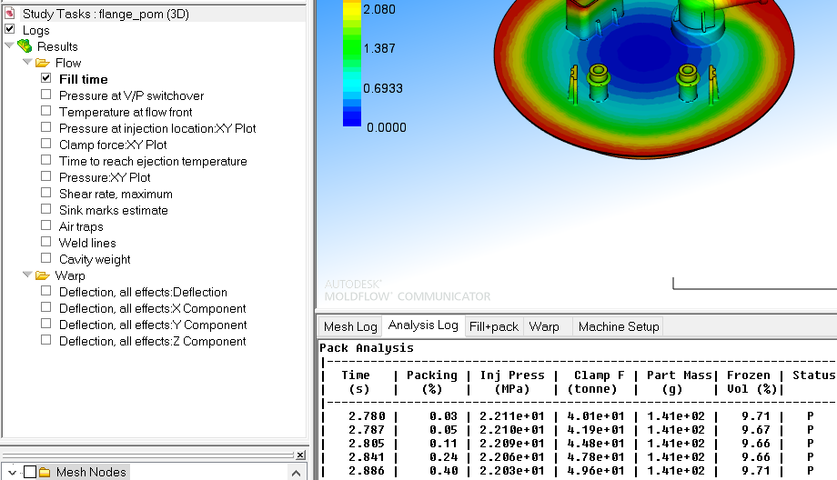
Log
Display of particular simulation results (can be exported in .txt format) when option Logs is chosen

Slide 8
Help
Support – linked to Autodesk Knowledge Network web
Troubleshooting – description, cause and solution of troubles with filling, cooling, shrinkage etc.

Slide 9
Download
Autodesk Moldflow Communicator 2019 free download:
https://www.autodesk.com/products/moldflow/communicator-viewer

Slide 10
Ing. Petr Halaška
halaska@smartplast.cz
+420 602 511 309
www.smartplast.cz

